Slide 1
INTRODUCTION TO GITHUB
Dr. Gurpreet Singh Tuteja

Slide 2
Introduction
What is Git & Github ?
Github Structure
Important Concepts for Github Users
Understanding Github workflow
Setting up Github
Github Desktop Demo

Slide 3


What is Git & Github ?
Git is an example of version control
Version control is a system that records changes to a file or set of files and helps us recall specific versions later if needed. E.g. Subversion (SVN), CVS etc
It allows you to :
Revert files or the whole project to an earlier state
Compare changes over time
See who modified what?
Control modifications by collaborators with the permission of admin/owners
Github is a repository hosting service for Git
While Git is a command line tool, GitHub provides a web-based graphical interface that works on top of GIT. It can also be treated as a social platform to share knowledge and work.
It also provides access control and several collaboration features, such as
wikis and basic task management tools

Slide 4
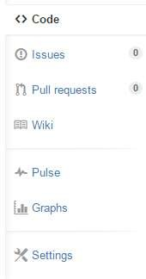
Github Structure
Personal user account
Organization account
REMOTE REPOSITORY
PUBLIC
PRIVATE
PUBLIC
PRIVATE
Unlimited public repositories and collaborators on all plans
Limited Private repositories
Ability to add unlimited
repository collaborators
Public repositories are open to view and copy but not commit changes.
Organizations are great for that need multiple owners & admins.
Limited private repositories (> Personal)
Team-based access
permissions
Unlimited owners, admins, & collaborators using teams
SYNC
CLONE TO GET LOCAL REPOSITORY

Slide 5
Important Concepts for Github Users
Creating a repo
Creating a repository for multiple people to work together
Master in a repository
This is the final version that is considered ready to use by anybody in the team or outside if repository is public.
Creating a Branch
Create a branch in your project, for an environment where you can try out new ideas.
Changes you make on a branch don't affect the master unless pull request is accepted.
Changes committed to branch reflects for you to keep track of different versions
Adding Commits
Keeps track of your progress as you work on a branch or master.
Creates a transparent history that others can follow to understand what you've done and why.
Forking a repository
It creates a copy for you to work on independently without any changes to theirs.
Submit a pull request to owner so that the owner can incorporate changes.

Slide 6

Concepts for Github Users .. Cntd
Pull requests
Pull Requests initiates discussion about your commits or changes made to a code.
See exactly what changes would be merged if pull request is accepted.
Use GitHub's @mention system in your Pull Request message to ask for feedback from specific people or teams, or for someone to review your work
Issues
Highlight bugs or issues with codes that need rectification.
Issues remain open unless resolved.
Can be filtered, Can be labeled as bug/enancement/ question/help wanted etc
@mention can be used to notify someone
Markdown syntax
Markdown is a way to style text on the web.
Available in descriptions and comments of Issues and Pull Requests. These include @mentions as well as references to SHA-1 hashes, Issues, and Pull Requests
Watch and Star
Watch notifies us of all conversations over and above your @mentions, commits,
comments on discussion. Star will favorite it but not show on your dashboards like watch

Slide 7
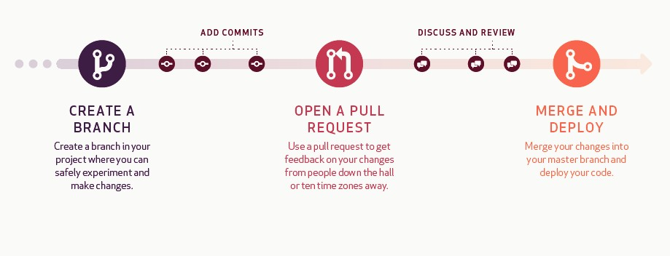
Understanding Github Workflow
*Deploying the code is for development projects
Commit
Comment on Pull request
Close Pull request
Compare
Sync or Push to branch
Add Issues/ Resolve Issues Mention Individuals
Git flow: https://guides.github.com/introduction/flow/

Slide 8
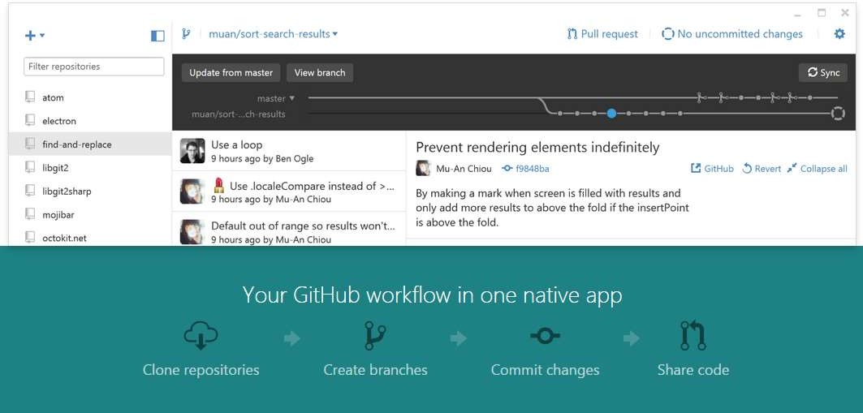
Github Desktop Demo
Link to download Github Desktop : https://desktop.github.com/

Slide 9
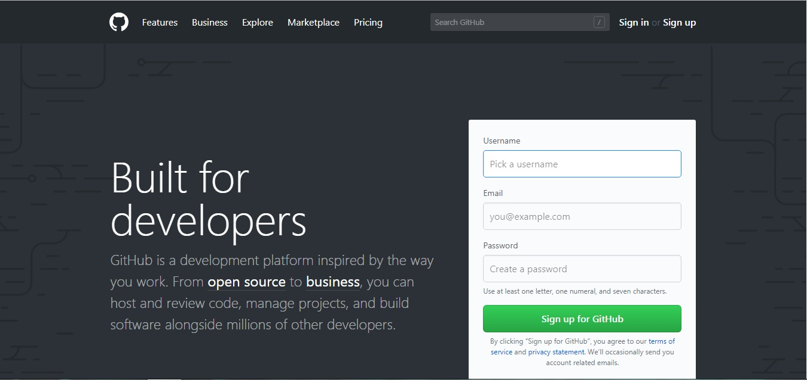

Slide 10
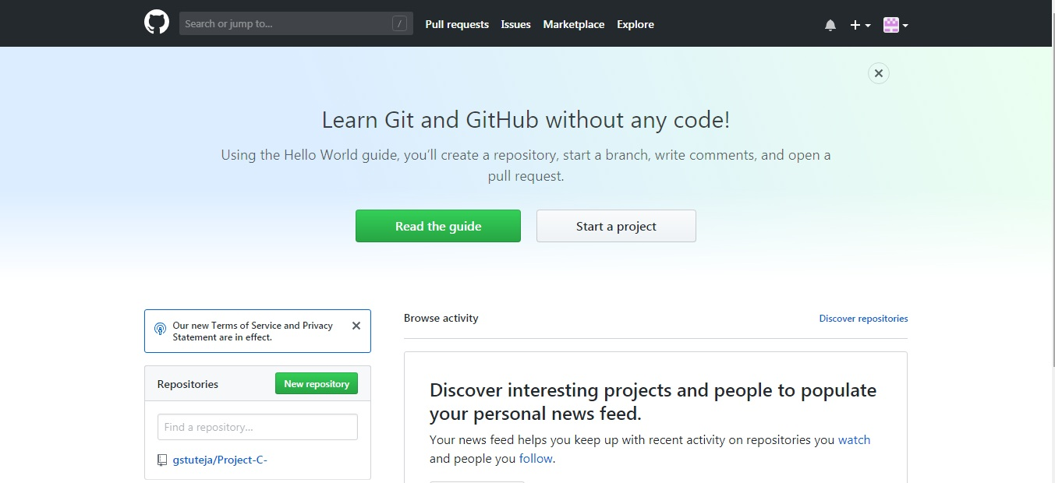

Slide 11
RESOURCES
https://help.github.com/
http://guides.github.com
https://www.youtube.com/watch?v=_3lU2LDQdUU

Slide 12
Thank You

